Slide 1

CSRF (Web Security)
Dr. Muhammad Umar Aftab

Slide 2

Outline
Cross-Site Requests
CSRF Attack
Counter Measures

Slide 3
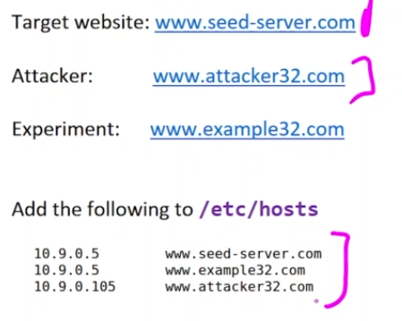
Lab Setup

Slide 4
Cross-Site Request and CSRF
Understanding of CSRF attack
Notes:
Cross-site Request Forgery (CSRF)

Slide 5

Single-Site Request

Slide 6
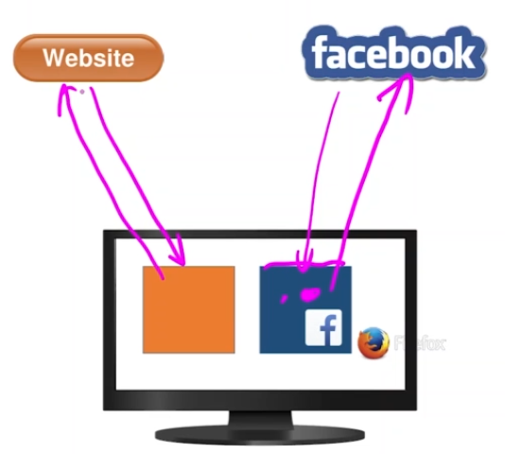
Single-Site / Same -site Request

Slide 7
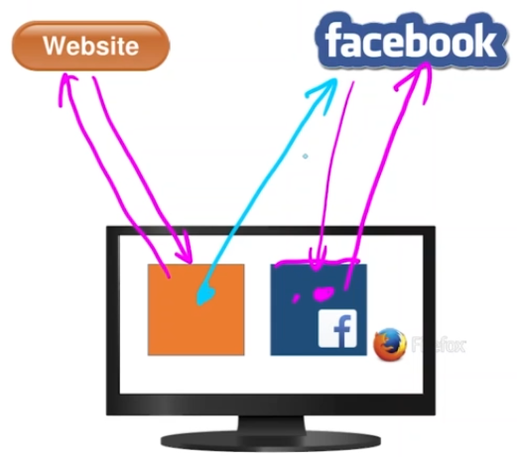
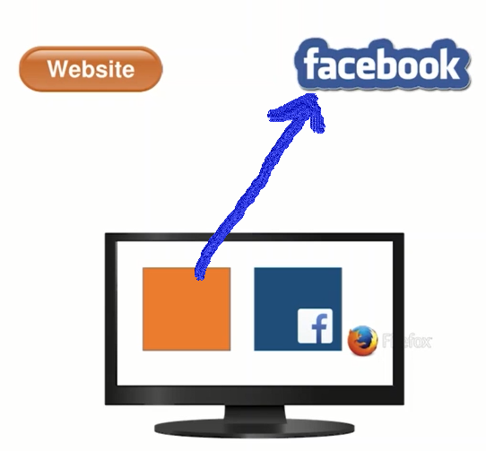
Cross-Site Request
Suppose a user opens two different web pages of different websites i.e., 1) www.facebook.com 2) www.web.com. The user is login in Facebook, and session ID is created.
The web.com page has a form of facebook.com. As you fill the facebook form on web.com. The request will send to facebook server.

Slide 8
Cross-Site Request Vulnerability
As user send request to facebook server through web.com. The cookies of facebook web page will automatically attached with the request. This is not hijacking, but this is natural behaviour of browser. But web.com can copy the session easily. So, this is a vulnerability of cross-site request.
Second Vulnerability:
Suppose a request is send through a webpage web.com to facebook server. If the facebook server don’t know that where this request come from. Then facebook server will respond to web.com page with user data. This is also a vulnerability.
Notes:
The second site attach the cookies of first site and send to the server. So one site is using the cookies of another site (Vulnerability)

Slide 9
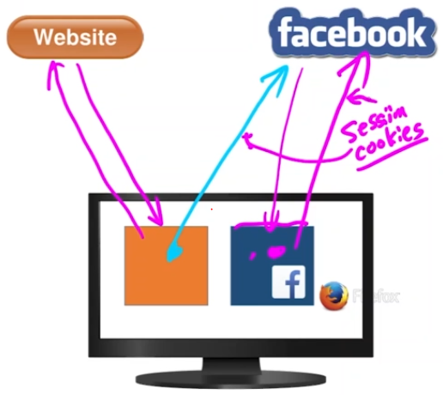
Cross-Site Request Vulnerability
There is a type of cookies “Session cookie”. That can attach to both sites.
That may cause the problem

Slide 10
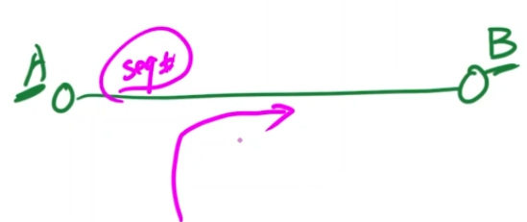
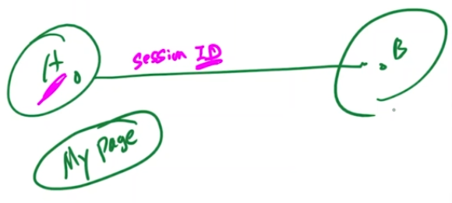
Session Hijacking
In TCP, if you will get the seq # then you can hijack the session.
If I put my web page on victims computer and request will go from A to B.
Meanwhile, B can’t recognise the
Difference then it’s a problem.

Slide 11
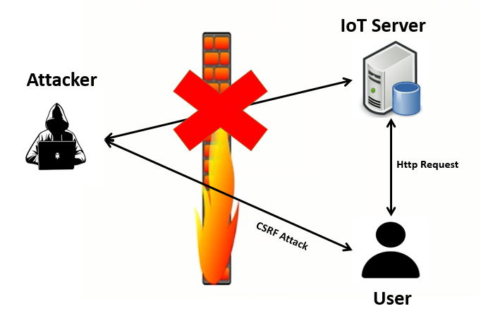
CSRF Attack on IoT devices
Notes:
IoT devices are cheaper that’s why they don’t have much security.

Slide 12
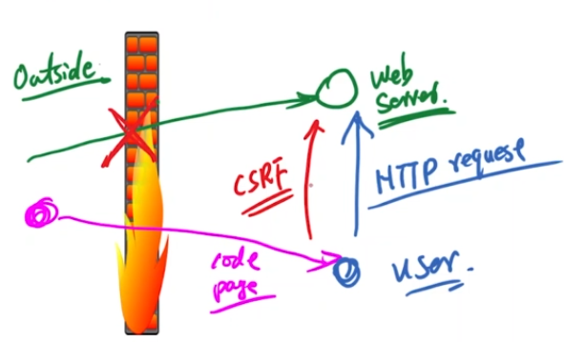
CSRF Attack on IoT devices
As the IoT devices don’t have countermeasures to deal with CSRF attack.
They use web server for their working.

Slide 13
How to Launch CSRF Attack
The attacker must know about method of http request before launch the attack.
The method can be GET or POST that can be analysed through “Http header live” extension in Firefox browser or Wireshark.
In the Get method, the data is attached in header of http request and user can see the data in url. But in the post method, the data is attached in body part of http request.

Slide 14
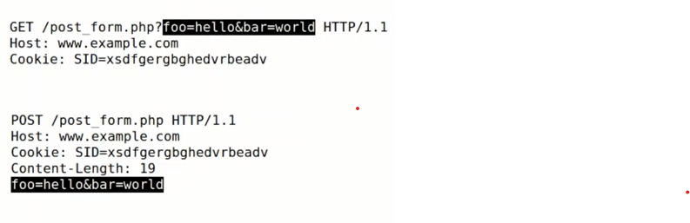
GET and POST Request
GET versus POST
GET has data in the URL portion
POST has data in the body portion.

Slide 15
CSRF Attack on GET Services
The Objective of this attack is to add attacker as friend victim’s friend

Slide 16
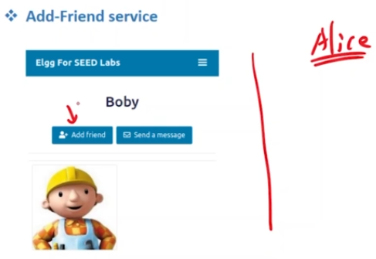
Add Friend Http Request
Our job is to add ourself in someone’s friend-list without their consent.
Alice click on add friend. We can observe the GET request.

Slide 17
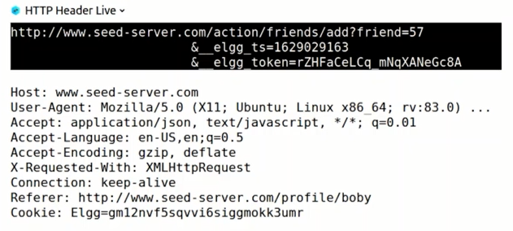
Investigate the GET method
The attacker will investigate the GET method request before launch the attack.
Goal is to capture that traffic → we note the value of “add friend”
Disable the countermeasures. → if they are attached (doesn’t matter)

Slide 18
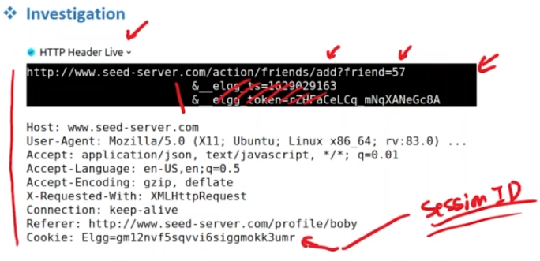
Investigate the GET method
All we need to know is the friend’s ID
Randomly generated session ID granted after giving the login credentials
By design browser add it for us.

Slide 19
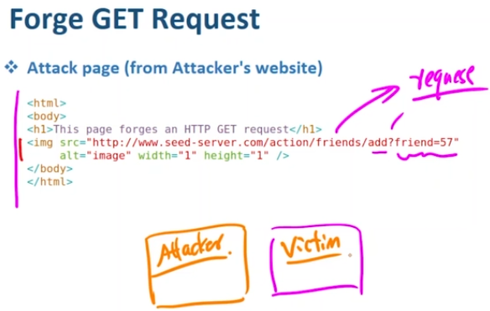
Preparation of Forge GET Request
Now attacker will prepare forge GET request in webpage with its own ID. As victim will click on page link, forge GET request will trigger.
You have to play with their minds → once user will click on this request then friend request will be sent.
Victim needs to have an active session with the social media site

Slide 20
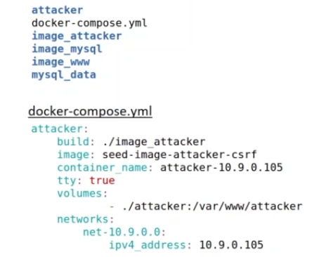
Demo: Lab Setup
Based on lab setup 2.0
It is based on containers
The code is inside the ‘attacker’ folder

Slide 21
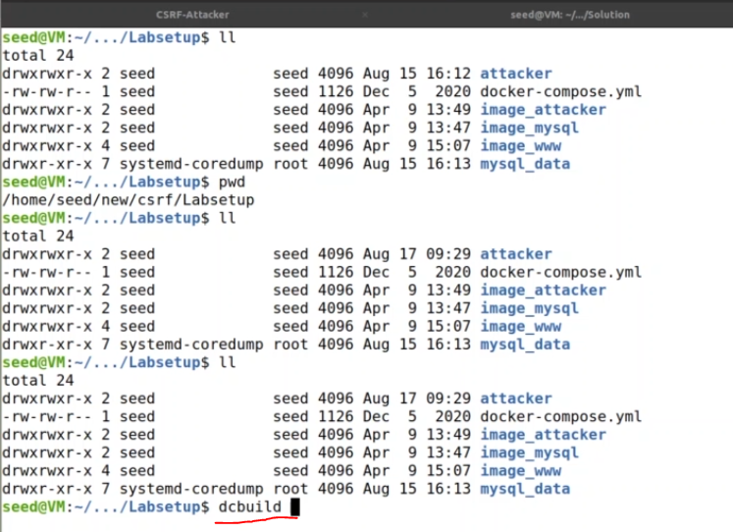
Demo: Lab Setup
docker build and it
Takes time
Notes:
Docker is a container service which allows one to run applications or even operating systems on a host operating system as containers. Containers are a new and exciting technology that has evolved over the last couple of years and being adopted by a lot of key organizations

Slide 22
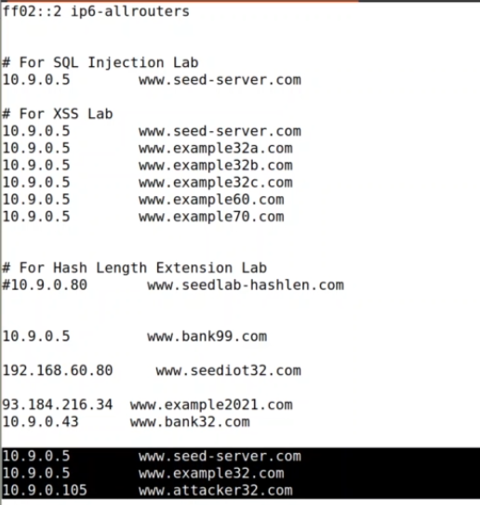
Demo: Lab Setup
run dcup → your container starts running
Now check the mapping of IP
run more /etc/hosts

Slide 23
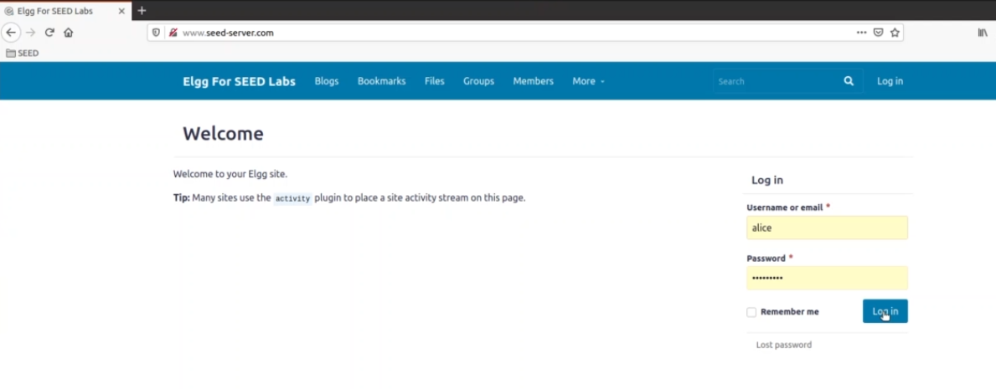
Demo: Lab Setup

Slide 24
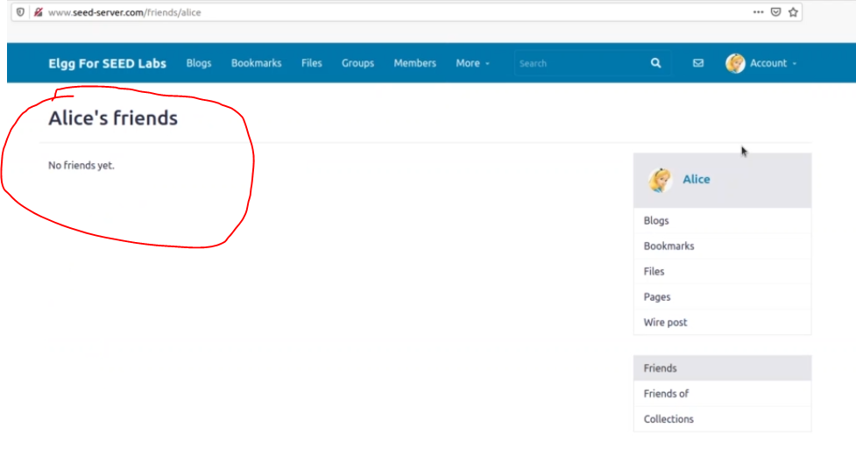
Demo: Lab Setup

Slide 25
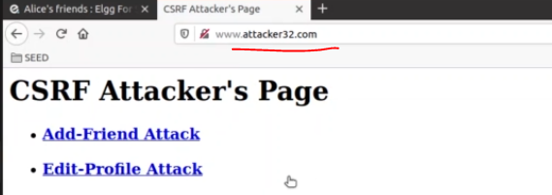
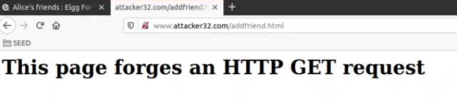
Demo: Open attacker’s website
Notes:
Nothing happen

Slide 26
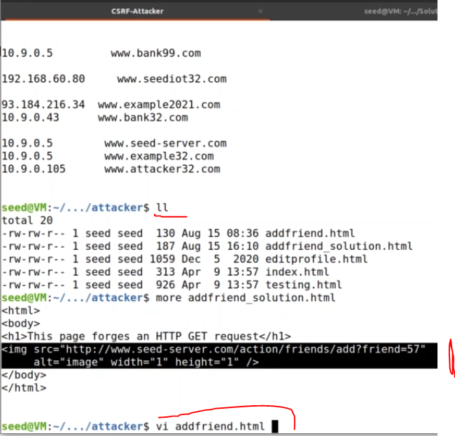
Demo:
Add your code in the page so that
the friend can be added

Slide 27
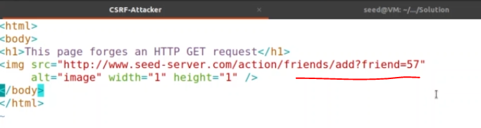
Demo:
whoever you want, just mention the ID → that person will be added in the friend’s list.
Refresh the pages again and check the results

Slide 28
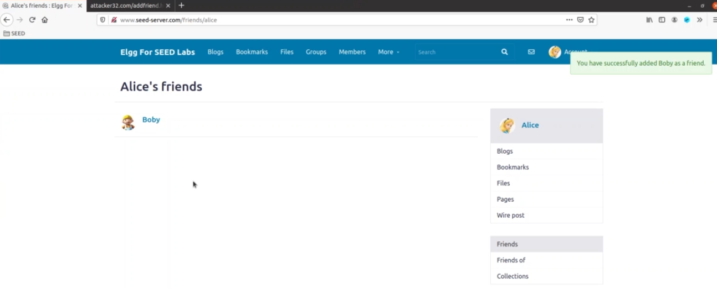
Demo: Friend added in the victim’s friend’s list
Notes:
Nothing happen

Slide 29
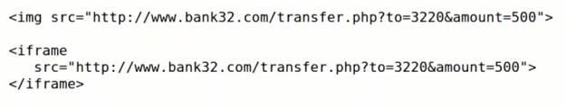
Forge the GET Request
The browser trigger GET request as it see “img” or “ifram” tag in HTML.
Attack on GET Http request is easy. Because data is attached in header of Http request or url.

Slide 30
Mechanism (Forge the GET Request)
Suppose Alice and Samy(Attacker) are two user on social network like Facebook.
Samy wants to add Alice in his friend list without Alice permission.
The Alice user is login in her account and her session ID is created.
Samy will send url of webpage to Alice that contain forge GET request with Samy profile ID.
As Alice click on link, the browser will trigger http GET request. The session ID of Alice will attach with request automatically.

Slide 31
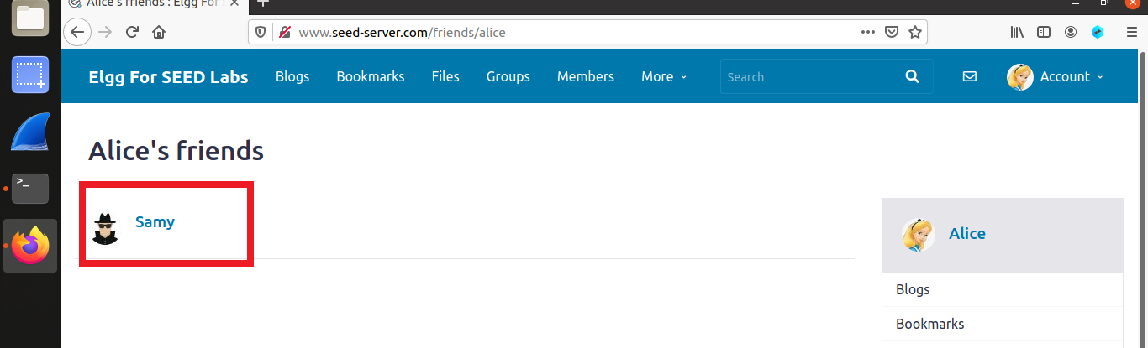
Reaction of CSRF GET Method Attack

Slide 32
CSRF Attack on POST
Services
The Objective of this attack is to edit the victim profile

Slide 33
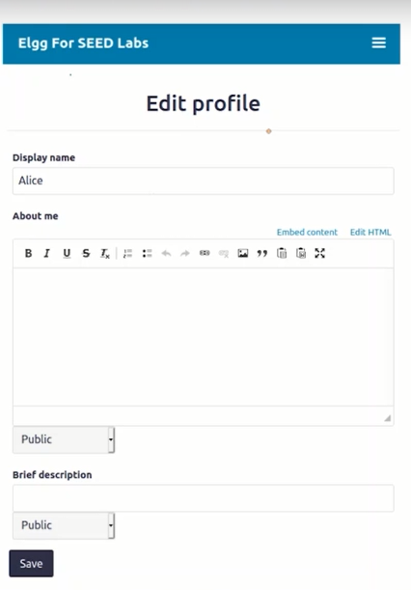
Edit Profile Http Request

Slide 34
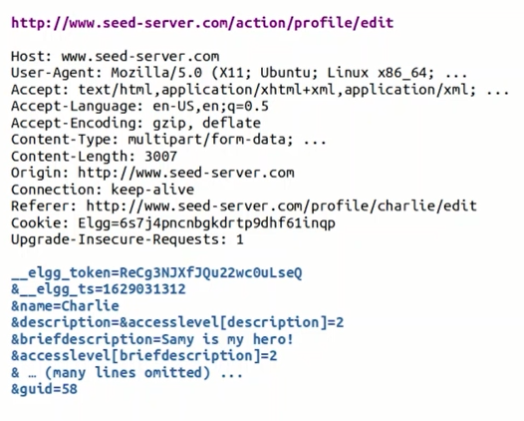
Investigate the POST method
The attacker will investigate the POST method request before launch the attack.

Slide 35
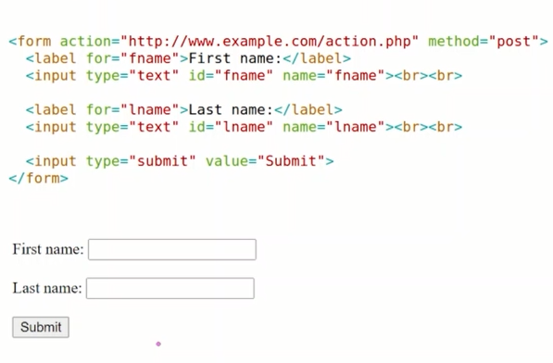
Sending POST Request
The POST request will send in forms because objective of attack is edit the victim profile.

Slide 36
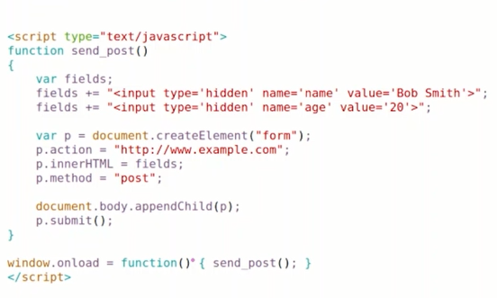
Preparation of Forge POST Request
Now attacker will prepare forge POST request in webpage with victim ID. As victim will click on page link, forge POST request will trigger.

Slide 37
Mechanism (Forge the POST Request)
Suppose Alice and Samy(Attacker) are two user on social network like Facebook.
Samy want to edit Alice profile without Alice permission.
The Alice user is login in her account and her session ID is created.
Samy will send url of webpage to Alice that contain forge POST request with Alice profile ID.
As Alice click on link, the browser will trigger http POST request. The session ID with attach automatically.

Slide 38
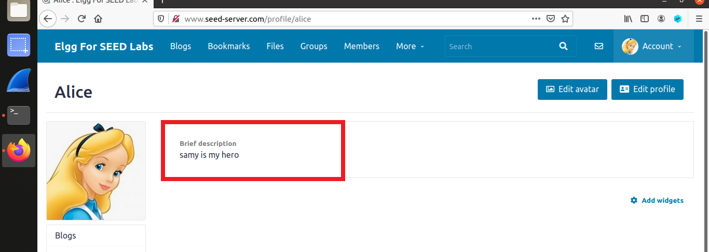
Reaction of CSRF POST Method Attack

Slide 39
Countermeasures

Slide 40
Fundamental Cause
The browser knows that the http request is single-site or cross-site. But server don’t know. This is vulnerability, because protected shield must be deployed on server side not at browser side.
Referral Header:
The referral header tells to server that where the request come from. But referral header carry many user information that can hit user privacy. So, many users block referral header by proxy.
So, referral header is not reliable solution.

Slide 41
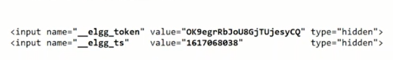
Secret Token
The server attach secret token with each webpage to know about request that it is single-site or cross-site.
The tokens are string of special characters. The property of token is hidden so that malicious user can not steal it.

Slide 42
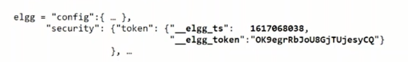
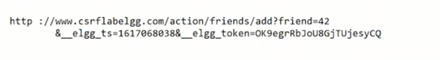
Secret Token
The developer can generate token inside page dynamically as follows:
Http Request with Token:

Slide 43
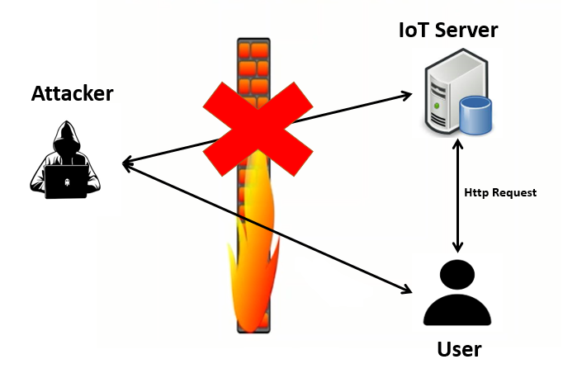
Token Approach in IoT

Slide 44
Same-Site Cookies
As request will send to Facebook server from webpage of web.com. The cookies of facebook.com will attached with request automatically.
The problem is that the Facebook server can’t recognize that request is come from Facebook webpage or web.com webpage.

Slide 45
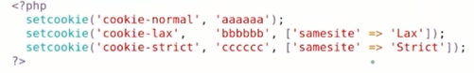
Setting Cookies and its types
The simple cookies are attached with cross-site request.
Lax cookies are sometime attached with cross-site request and sometime not (depend upon developer).
The strict cookies only attach with same site request.
Notes:
Lax allows the cookie to be sent on some cross-site requests, whereas Strict never allows the cookie to be sent on a cross-site request.

Slide 46


